Slide 1


LIBRARY M ANAGEMENT SYSTEM
A PROJECT REPORT
Submitted By:
Biswajit Swain(230720100113)
Sabya Sachi Rath(230720100101)
Snehashree Mohapatra(230720100082)
Jyoti Ranjan Jena(230720100080)
Abhishek Mohapatra(230720100106)
In partial fulfilment for the award of the degree of
MASTER IN COMPUTER APPLICATION
SCHOOL OF ENGINEERING AND TECHNOLOGY BHUBANESWAR CAMPUS
CENTURION UNIVERSITY OF TECHNOLOGY & MANAGEMENT
ODISHA 2023-2025

Slide 2
BONAFIDE CERTIFICATE
Certificate that this project entitled “Library Management System” is the bonafide work of “Biswajit Swain– 230720100113” who carried out the project under work under my supervision. This is to further certify to the best of my knowledge that this project has not been carried out earlier in this institute and the university.
<<Signature of the Supervisor>>
SIGNATURE
Prof. Subham Saho
(Dept. of Computer Science & Engineering)
Certified that the above-mentioned project has been duly carried out as per the norms of the college and statues of the university.
SIGNATURE
Prof. Rakesh Kumar Ray
PROFESSOR & HOD
DEPT. OF MCA, CUTM
DEPARTMENT SEAL

Slide 3
DECLARATION
I hereby declare that the project entitled “Library Management System” Submitted for the “Minor Project” of 1st semester MCA in IT infrastructure and management is my original work and the project has not formed the basis for the award of any Degree/Diploma or any other similar titles in any other University/Institute.
Name of the Student:
Signature of the Student:
Registration No:
Place:
Date:

Slide 4
ACKNOWLEDGEMNET
I wish to express my profound and sincere gratitude to Prof. Subham Saho, Department of MCA, SoET, Bhubaneswar Campus, who guided me into the intricacies of this project nonchalantly with matchless magnanimity.
I thank Prof. Rakesh K Ray, Head of the Dept. of Department of MCA, SoET, Bhubaneswar Campus and Prof. Sujata Chakravaraty, Dean, School of Engineering and Technology, Bhubaneswar Campus for extending their support during Course of this investigation.
I would be failing in my duty if I don't acknowledge the cooperation rendered during various stages of image interpretation by Prof. Subham Saho.
I am highly grateful to prof Subham Saho who evinced keen interest and invaluable support in the progress and successful completion of my project work.
I am indebted to Subham Saho for their constant encouragement, cooperation and help. Words of gratitude are not enough to describe the accommodation and fortitude which they have shown throughout my endeavor.
Name of the Student:
Signature of the Student:
Registration No:
Place:
Date:

Slide 5
ABSTRACT
The Library Management System is a straightforward C program designed for managing a library's inventory. The system includes essential features such as adding new books with details like name, author, cost, and number of pages, displaying a comprehensive list of all stored books, indicating the total number of books in the library, facilitating the issuance of books based on availability, and providing an option to exit the program. The administrator can navigate through these functionalities using a menu-driven interface. This system offers a simplified solution for handling library operations, emphasizing basic book management tasks, and is tailored exclusively for administrative use.

Slide 6
CONTENT
SL NO. | SUBJECT | PAGE NO.
01 | Introduction | 01
02 | Objective | 02
03 | About C | 03
04 | Algorithm | 04
05 | Source Code | 05-07
06 | Output | 08-14
07 | Conclusion | 15
08 | References | 16

Slide 7
INTRODUCTION
The project titled LIBRARY MANAGEMENT SYSTEM is a software for monitoring and controlling the transaction in the library The project is developed in C , which mainly focuses on the basic operations in a library like adding new book and members, facility to borrow and return books.
Records for libraries are kept up to date using a library management system. It keeps track of the number of books in the library, how many are issued, how many are returned,how many have late fines accessed. With this system books may be promptly located, A library management system’s goal is to instantly and accurately offer information about any type of book, saving a great deal of time and effort.

Slide 8
OBJECTIVE
The main objective of the Library Management System is to manage the details of address,member, issue,books, student, it manage all the information about address, librarian,student, address.
The project is totally built at administrative end and thus only the
administrative is guaranteed the access.
The purpose of the project is to build a program to reduce the manual
work for managing the address, member, librarian, issues.
It tracks all the details about the issues, books, student.
The main object of the system is to automate the exiting system so
that searching, borrowing and returning books will be faster.

Slide 9
ABOUT C
C is a general-purpose, imperative computer programming language supporting structured programming, lexical variable scope, and recursion, while a statictype system prevents unintended operations. By design, C provides constructs that map efficiently to typical machine instructions, and has found lasting use inapplications previously coded in assembly language. Such applications include operating systems, as well as various application software for computers ranging from super computers to embedded systems.
C was originally developed at Bell Labs by Dennis Ritchie between 1972and1973tomakeutilitiesrunningonUNIX.Later,itwasappliedtore
-implementing the kernel of the UNIX operating system. During the 1980s,
C gradually gained popularity. Nowadays ,it is one of the most widely used programming languages, with C compilers from various vendors available forthe majority of existing computer architectures and operating systems. C has been standardized by the American National Standards Institute since 1989 and subsequently by the International Organization for Standardization.
C is an imperative procedural language. It was designed to be compiled using a relatively straight forward compiler, to provide low-level access to memory, to provide language constructs that map efficiently to machine instructions, and to require minimal runtime support. Despite its low-level capabilities, the languagewas designed to encourage cross-platform programming. A standards- compliantC program that is written with portability in mind can be compiled for a wide variety of computer platforms and operating systems with few changes to its source code; the language has become available on various platforms, from embedded micro controllersto super computers.

Slide 10
ALGORITHM
Step 1: Declare a structure which holds data members
Step 2: Declare variables which are required for loop.
Step 3: Use switch case to work on each module.
Step 4: Case 1- For adding book information
Case 2- For displaying book information
Case3- For displaying total no.of books.
Case 4- For issuing a book
Case 5- For exiting the program.

Slide 11
SOURCE CODE
#include <stdio.h>
#include <stdlib.h>
#include <string.h>
struct library
{
char book_name[100];
char author_name[100];
float cost;
int no_of_pages;
int is_available;
};
int main()
{
struct library lib[100];
char book_name[100];
int i, j, count;
i = 0;
j = 0;
count = 0;
while (j != 6)
{
printf("\n\n-------------------------------------------------\n");
printf("1. Add Book details\n");
printf("2. Display the list of books and its details\n");
printf("3. Display the total no. of books in the library\n");
printf("4. Issue a book\n");
printf("5. Exit\n\n");
printf("-------------------------------------------------\n\n");
printf("Enter the number: ");
scanf("%d", &j);

Slide 12
switch (j)
{
case 1:
printf("\nYou can add the details of the book\n");
printf("Enter the book name: ");
scanf("%s", lib[i].book_name);
printf("Enter the author name: ");
scanf("%s", lib[i].author_name);
printf("Enter the number of pages: ");
scanf("%d", &lib[i].no_of_pages);
printf("Enter the cost of the book: ");
scanf("%f", &lib[i].cost);
lib[i].is_available = 1;
count = count + 1;
i = i + 1;
break;
case 2:
if (count == 0)
{
printf("\nThere are no books stored!!\n\n");
}
else
{
printf("\nYou can view the list of books\n");
printf("The list of books are: \n");
for (i = 0; i < count; i++)
{
printf("The name of the book is: %s\n", lib[i].book_name);
printf("The name of the author is: %s\n", lib[i].author_name);
printf("The number of pages are: %d\n", lib[i].no_of_pages);
printf("The cost of the book is: %f\n", lib[i].cost);
printf("Availability: %s\n", lib[i].is_available ? "Available" : "Not Available");
printf("\n");
}
}

Slide 13
break;
case 3:
printf("\nTotal number of books in the library are: %d\n\n", count);
break;
case 4:
printf("\nEnter the name of the book you want to issue: ");
scanf("%s", book_name);
for (i = 0; i < count; i++)
{
if (strcmp(lib[i].book_name, book_name) == 0)
{
if (lib[i].is_available)
{
printf("\nBook '%s' has been issued.\n", lib[i].book_name);
lib[i].is_available = 0;
}
else
{
printf("\nSorry, the book '%s' is not available for issuing.\n", lib[i].book_name);
}
break;
}
}
if (i == count)
{
printf("\nBook '%s' not found in the library.\n", book_name);
}
break;
case 5:
exit(0);
break;
default:
printf("\nINVALID INPUT!!\n");
}
}
return 0;
}

Slide 14
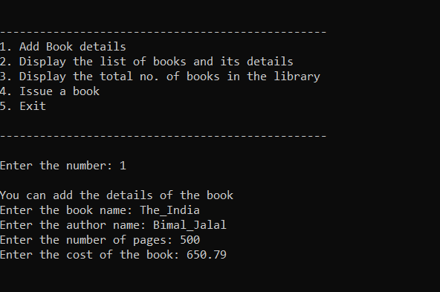
OUTPUT
Using switch option 1 to add a book
The following details are to be given as input:
Name of the book
Name of the author
Total no.of pages in the book.
The cost of the book.

Slide 15
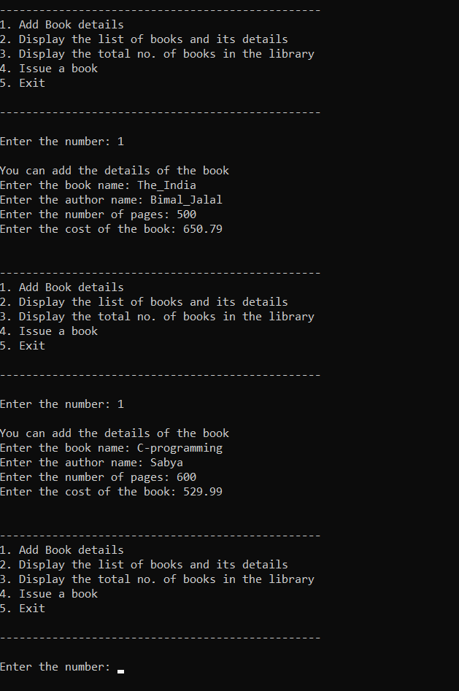
Add Details for 2nd book.

Slide 16
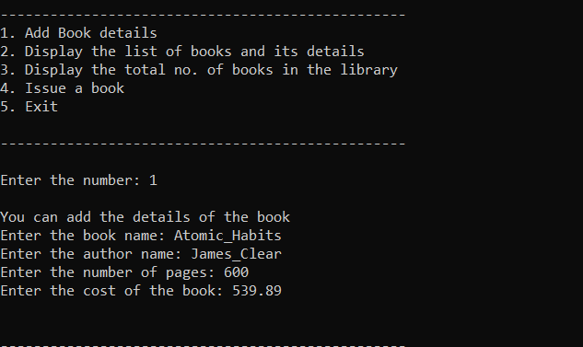
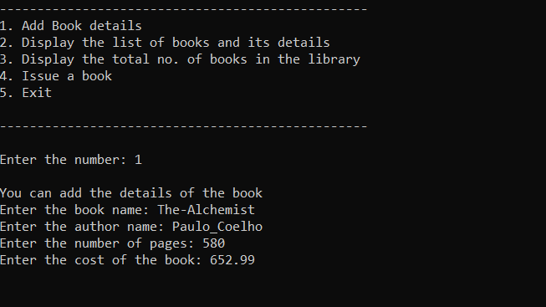
Add Details for 3rd book and 4th book.

Slide 17
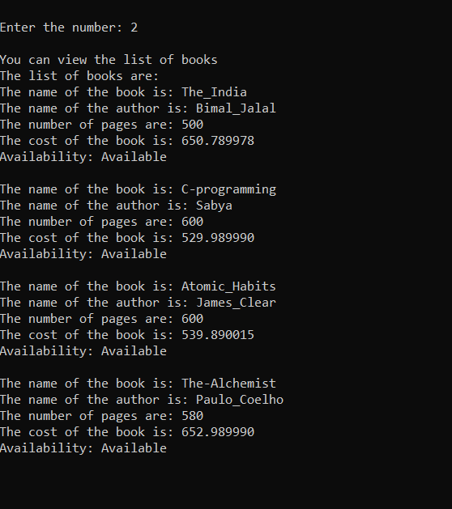
Display list of books in the library.

Slide 18
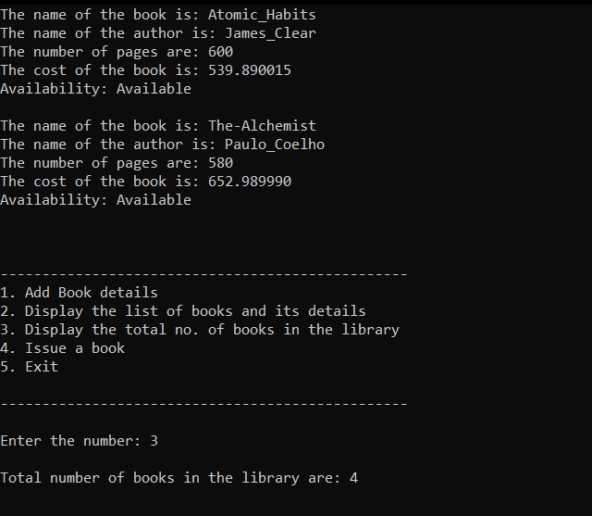
Display the total number of books in the library.

Slide 19
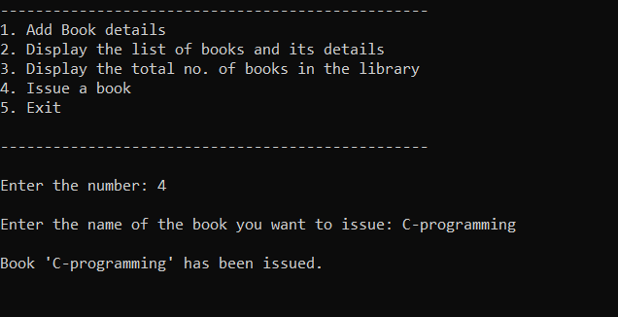
Issue the book “C-programming”.
Now display the list of books in the library.
The availability status of the book “C-programming” will now be displayed as “Not Available.

Slide 20
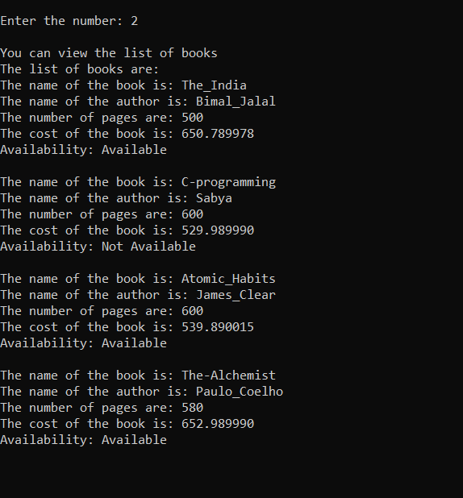
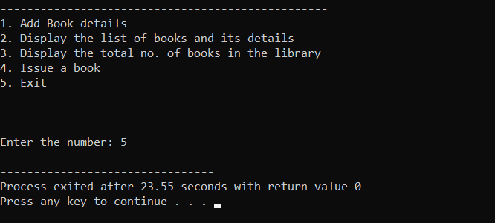
Display list of books after issuing “C-programming” book.
Exit

Slide 21
Conclusion
The project Library Management System is for computerizing the working in a library.
The software takes care of all the requirements of an a library and is capable to provide easy and effective storage of information related to books and users.
……………….*****…………………

Slide 22
References
https://www.geeksforgeeks.org/
https://www.javatpoint.com/
https://www.w3schools.com/
https://www.youtube.com/@SimplilearnOfficial
……………….*****…………………

